Slide 1

Customer Lifetime Value
for
Auto Insurance Company

Slide 2
Agenda
Problem Statement
Business Overview
Data Collecting and Pre-processing
Model Building
Regression Analysis
Model Assumptions
Business decisions and recommendation.

Slide 3

Problem Statement
For an Auto Insurance company, predict the customer life time value (CLV). CLV is the total revenue the client will derive from their entire relationship with a customer.
The Customer Lifetime Value is the net present value of a customer. It considers the difference between the total amount of revenues from a customer and the companies` expenses for this customer during the whole duration of relationship.
Customer lifetime value is important because, the higher the number, the greater the profits.

Slide 4
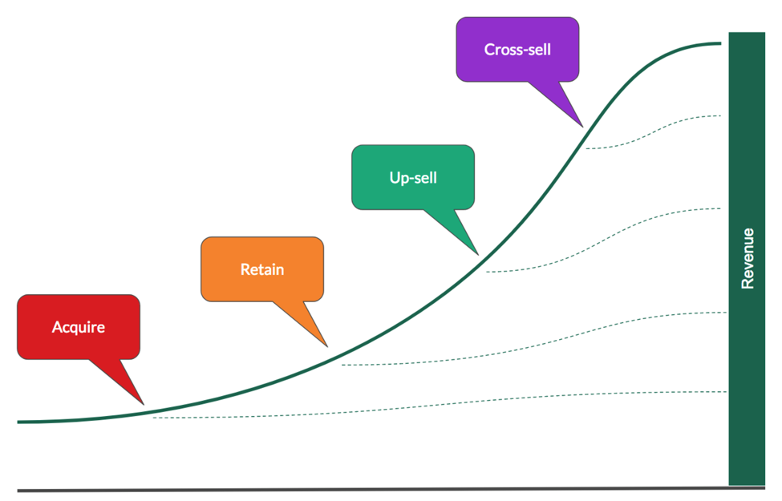
Business Overview

Slide 5
CLV Helps to answer this……
More Efficient Customer Retention
Better Cross / Up selling
Do the Customer have high probability of cross-selling?
Do the Customer have high potential?
PROFIT
More Efficient acquisition of new customers
Recovery of Potential Valuable Customers
Do the Customer have low potential?
Do the new customer has same profile as valuable customer?
PROFIT
Faster Termination of Less Valuable Customer
TIME
Acquisition
Retention
Termination

Slide 6
Data Collecting and Pre-processing
Given dataset with : Observations- 9134
Variables – 24.
Dataset has been collected in a “.csv” format. Examined the dataset with all variables included. Understand the importance of each variable in the dataset. Checking with data type of variables and how much relevant information they are providing for model building.
Removing the explanatory variables which doesn’t make any sense in predicting response variable.
Here Customer ID doesn’t make any sense in predicting values, so removed it.
Detecting and treating outliers.
Splitting dataset into two model:
- Development Model
- Testing Model

Slide 7

Model Building

Slide 8
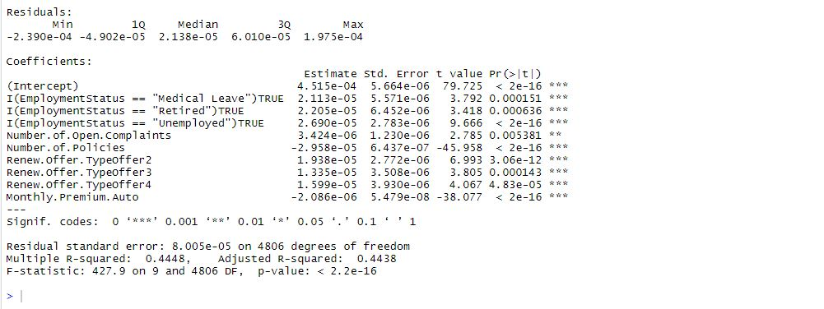
Regression Analysis

Slide 9
Customers getting new offers on policies tends to score high lifetime value and long term relationship with company. On every single offer type lifetime value of customer is increasing as there is positive relationship.
As the monthly premium is less, longer the relationship of customer with company can be observed and potential increase in lifetime value. As monthly premium is greater, there is less possibility to end up with short term business benefits for company.
With the less number of policies customer are tend to continue their relationship with company and results into high customer lifetime value. With less number of policies customer are more likely to pay premium regularly.
Customers with more number of complaints are more interacted with company and that results into making them more satisfied customer for long term relationship.
Employment status contributing positively in lifetime value. Every couple of years, getting increased in lifetime value.

Slide 10
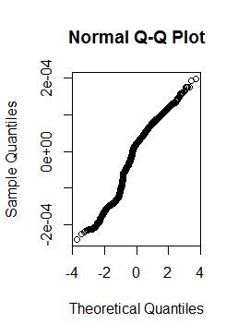
Model Assumptions
Auto-correlation
Multicollinearity
Constant Error Variance
Normality

Slide 11
Business Decisions and recommendation
Customers with moderate valued can be converted into highly valued customer by providing good offers on policies. It has been observed that customers with renew offer type more liked high value customer. Making new offers on policies will help to make customer high value.
Association of customer with company for longer period of time will automatically make the lifetime value high. Keeping monthly premium amount small but for longer period of time will help company to have long time association with customers. And customers also will be comfortable to pay small amount of money on every month regularly.
Customers with less number of policies tends to be more interested to continue so rather than going for number of policies with single customers. It will help to increase customer base also. Different customers with high lifetime value will definitely results into good business decision.
Improving customer service is important, the more customer satisfied, the more business can be improved. Number of open complaints shows that company having to way communication with customers which will allow to customer to know the policies of company more. Company also can be aware with customer requirement and improve itself as per the market. To retain the customer by satisfying their need through their complaints.

Slide 12
Thanks you!

